Slide 1
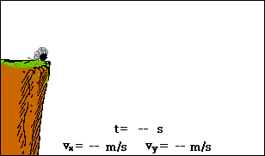
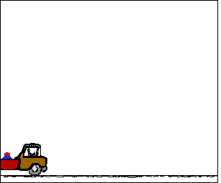
Motion in Two Dimensions
Chapter 7.2

Slide 2
Projectile Motion
What is the path of a projectile as it moves through the air?
Parabolic?
Straight up and down?
Yes, both are possible.
What forces act on projectiles?
Only gravity, which acts only in the negative y-direction.
Air resistance is ignored in projectile motion.

Slide 3
Choosing Coordinates & Strategy
Choose the y-axis for vertical motion where gravity is a factor.
Choose the x-axis for horizontal motion. Since there are no forces acting in this direction (of course we will neglect friction due to air resistance), the speed will be constant (a_{x} = 0).
Analyze motion along the y-axis separate from the x-axis.
If you solve for time in one direction, you automatically solve for time in the other direction.
Horizontally launched projectiles (0 degrees) have an initial velocity of $0m/s$ in the vertical direction ($v_{iy}=0)$.
For projectiles launched at angles other than zero degrees, you will want to find the x and y components of the initial velocity.

Slide 4
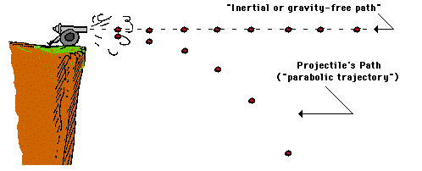
The Trajectory of a Projectile

Slide 5
The Vectors of Projectile Motion
What vectors exist in projectile motion?
Velocity in both the x and y directions.
Acceleration in the y direction only.
v_{x} (constant)
a_{x} = 0
v_{y} (Increasing)
Trajectory or Path
a_{y} = -9.8m/s²
Why does the velocity increase in the y-direction?
Gravity.
Why is the velocity constant in the x-direction?
No force acting on it.

Slide 6
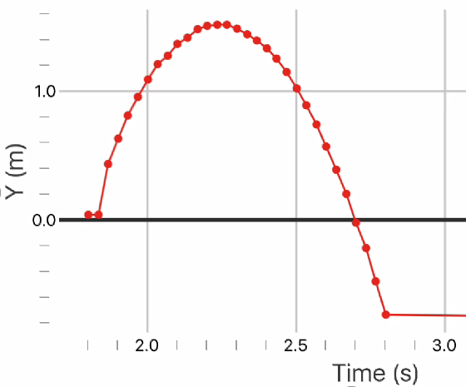
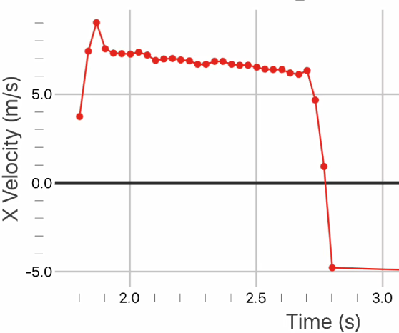
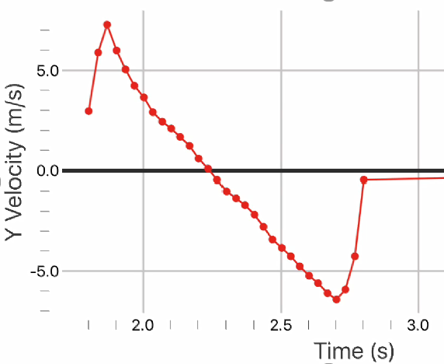
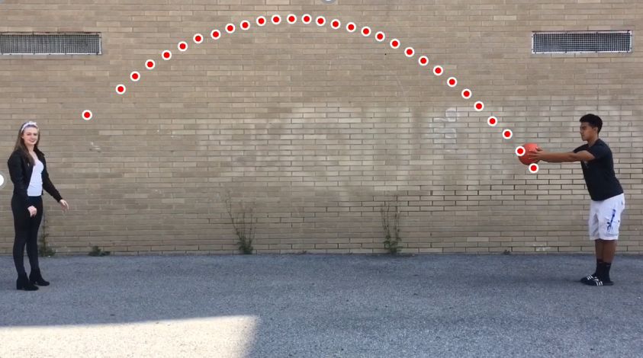
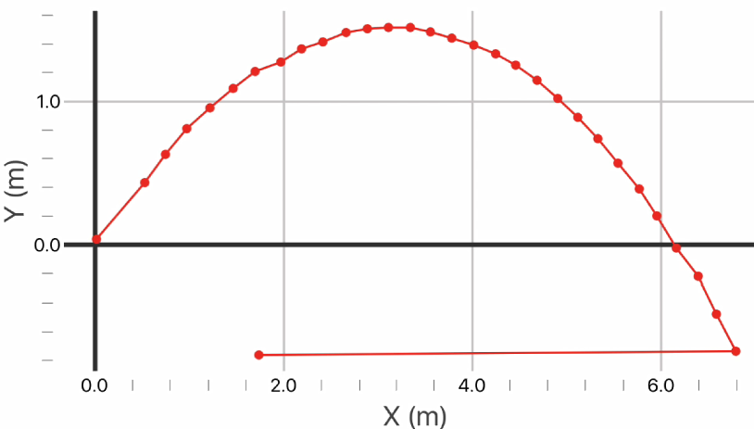
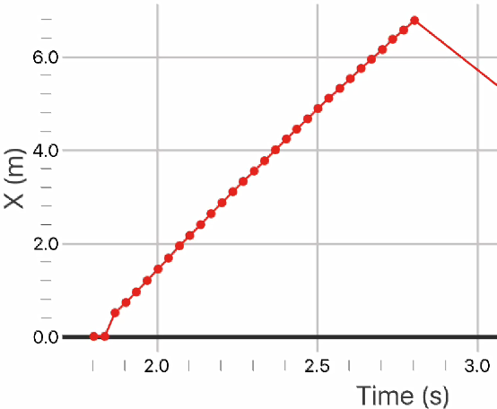
Analyzing the motion of a projectile
Note parabolic path.
Speed is constant in x-direction.
Speed decreases, then increases in y-direction.
Slope of velocity vs. time curve is constant = g (-9.8 m/s²).
Slope = speed
Constant
Slope = accel.
Constant

Slide 7
Ex. 1: Launching a Projectile Horizontally
A cannonball is shot horizontally off a cliff with an initial velocity of 30 m/s. If the height of the cliff is 50 m:
How far from the base of the cliff does the cannonball hit the ground?
With what speed does the cannonball hit the ground?

Slide 8
Diagram the problem
$$vi = 30m/s$$
$$Fg = Fnet$$
$$a = −g$$
$$50m$$
$$vx$$
$$vy$$
$$vf = ?$$
$$d_{x} = ?$$

Slide 9
State the Known & Unknown
Known:
$vix = 30 m/s$
$viy = 0 m/s$
$a = −g = −9.81m/s2$
$dy = −50 m$
Unknown:
$dx at dy= −50 m$
$vf = ?$

Slide 10
Perform Calculations (y)
Strategy:
Use reference table to find formulas you can use.
$vfy = viy + gt$
$dy = viyt + ½ gt2$
Note that g has been substituted for a.
Use known factors such as in this case where the initial velocity in the y-direction is known to be zero to simplify the formulas.
$vfy = viy + gt$ $vfy = gt$ (1)
$dy = viyt + ½ gt2$ $dy = ½ gt2$ (2)
(Use the second formula (2) first because only time is unknown)

Slide 11
Perform Calculations (y)
Now that we have time, we can use the first formula (1) to find the final velocity.
$vfy=gt$
$vy=(−9.8 m/s2)(3.2 s)=−31 m/s$

Slide 12
Perform Calculations (x)
Strategy:
Since you know the time for the vertical(y-direction), you also have it for the x-direction.
NOTE: Time is the only variable that can transition between motion in both the x and y directions.
Since we ignore air resistance and gravity does not act in the horizontal (x-direction), $ax = 0$.
Choose a formula from your reference table
$dx=vixt+½ axt2$
Since $ax=0$, the formula reduces to $d_{x}=vixt$
$dx=(30 m/s)(3.2 s)=96 m$ from the base.

Slide 13
Finding the Final Speed ($vf$)
We were given the initial x-component of velocity, and since there is no acceleration in the horizontal direction, $vix = vfx$ $=30m/s$.
In the first part of the problem, we determined the vertical component of velocity at the moment of impact to be $vfy$ $=−31m/s$.
We will use the Pythagorean Theorem to solve for $vf$.
$$vfx = 30m/s$$
$$vfy = −31m/s$$
$$vf = ?$$

Slide 14
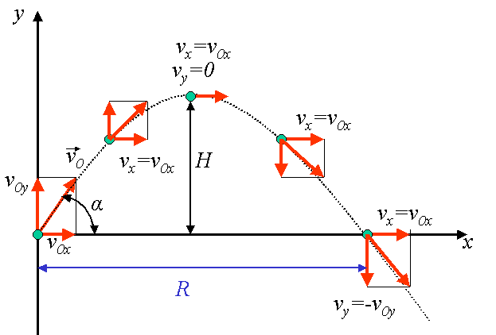
Projectiles Launched at angles other than 0 degrees.
If a projectile is launched at an angle greater than 0º, then v_{y} will be 0 m/s at the very peak of its trajectory.
A common misconception is that the acceleration = 0 m/s² at the peak as well. But it actually equals -9.8 m/s², and anywhere else along the path of the projectile
The magnitude of the initial launch velocity will be the same as the final velocity if the projectile lands at the same height from which it is launched.
If the projectile lands at the same height from which it is launched, then $∆y=0$.
ox
ox
o
ox
iy
ox
ox
v = v_{o}
oy

Slide 15
Breaking the initial velocity into its components
Begin by creating a right triangle with the vertical and horizontal components making up the a and b legs of the right triangle.
For the vertical and horizontal velocities, you need to use component vector analysis using trigonometry.
Why do you need to do this?
$$v_{ix}=v_{i}\cos{θ}$$
$$vi$$
$$viy$$
$$v_{iy}=v_{i}\sin{θ}$$
θ
$$vix$$

Slide 16
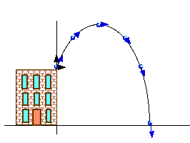
Ex. 2: Projectile Motion above the Horizontal
A ball is thrown from the top of the Science Wing with a velocity of 15 m/s at an angle of 50 degrees above the horizontal.
What are the x and y components of the initial velocity?
What is the ball’s maximum height?
If the height of the Science wing is 12 m, where will the ball land?

Slide 17
Diagram the problem
$$ay=−g$$
$$y$$
$$viy$$
$$vi=15 m/s$$
$$=50°$$
$$vi=15 m/s$$
$$vix$$
$$=50°$$
$$x$$
$$12 m$$
Ground
$$x = ?$$

Slide 18
State the Known & Unknown
Known:
$dyi=12 m$
$vi=15 m/s$
$=50°$
$ay=g =−9.8m/s2$
Unknown:
$dy(max) = ?$
$t= ?$
$dx= ?$
$viy= ?$
$vix= ?$

Slide 19
Perform the Calculations (y_{max})
y-direction:
Initial velocity: $viy=visin$
$viy =(15 m/s)(sin⁡50°)$
$viy =11.5 m/s$
Time when $vfy=0 m/s$: $vfy=viy+gt$(ball at peak)
$t =−viy / g$
$t =(−11.5 m/s)/(−9.81 m/s2)$
$t =1.17 s$
Determine the maximum height: $dy\left(max\right)=diy+viyt+½ gt2$
$dy\left(max\right)=12 m+\left(11.5\frac{m}{s}\right)\left(1.17s\right)+ ½ (−9.81 \frac{m}{s2})(1.17 s)2$
$dy\left(max\right)=18.7 m$
$$vyi$$
$$vi = 15 m/s$$
$$ = 50°$$
$$vxi$$

Slide 20
Perform the Calculations (t)
At the very peak of its trajectory, the velocity of the ball in the vertical direction will be zero ($viy = 0$).
We also know that at its peak, $dy\left(max\right)= 18.7m$.
Time from peak to when ball hits the ground:
From reference table:$dy\left(max\right)=viyt+½ gt2$
Since $viy$ can be set to zero, we can solve for $t$
$t=\sqrt{2∗\frac{d_{y\left(max\right)}}{g}}$
$t=\sqrt{\frac{2\left(−18.7m\right)}{−9.81m/s^{2}}}$
$t=1.95 s$
By adding the time it takes the ball to reach its maximum height (peak) to the time it takes to reach the ground will give you the total time.
$ttotal=1.17 s+1.95 s=3.12 s$

Slide 21
Perform the Calculations (x)
x-direction:
Initial velocity: $vix=vicos$
$vix=(15 m/s)(cos⁡50°)$
$vix=9.64 m/s$
Determine the total distance:$dx=vixt+½axt2$
Since$ax=0$, $dx=vixt$
$dx=(9.64 m/s)(3.12 s)$
$dx=30.1 m$
$$vyi$$
$$vi=15 m/s$$
$$=50°$$
$$vxi$$

Slide 22
Analyzing Motion in the x and y directions independently.
x-direction | y-direction
$$dx=vix t=vfxt$$ | $$dy=½ (v_{i}+vf) t$$ $$dy=vavg t$$
$$vix=vi∙cos$$ | $$vf=viy+gt$$
 | $$dy=viyt+½g{(t)}^{2}$$
 | $$vfy2=v_{iy}^{2}+2gd_{y}$$
 | $$viy=vi∙sin$$

Slide 23
Key Ideas
Projectile Motion:
Gravity is the only force acting on a projectile.
Choose a coordinate axis that where the x-direction is along the horizontal and the y-direction is vertical.
Solve the x and y components separately.
If time is found for one dimension, it is also known for the other dimension.

